Slide 1


Internet
SALES
Analysis

Slide 2

Agenda
03
Introduction
09
Power BI Data Model
04
Business Request
10
Dashboards and Features
05
Business Demand Overview
11
Dashboard Sales Overview
06
Schema
12
Dashboard Customer Details
07
SQL Query
13
Dashboard Product Details
08
Importing Data to Power BI
14
Thank you!

Slide 3

This project leverages Microsoft's AdventureWorksDW2022 database to conduct an Internet Sales Analysis, showcasing a comprehensive Data Analytics and Business Intelligence portfolio. The primary objective is to demonstrate the end-to-end (E2E) solution process for addressing a stakeholder's business request.
AdventureWorksDW2022 contains fictional data designed to emulate real-world business scenarios. It represents AdventureWorks, a hypothetical bicycle manufacturing company that distributes products through various channels, including internet sales and resellers.
In the following slides, you will be guided through a detailed data story that highlights the critical steps of:
Understanding the business request.
Breaking it down into actionable items.
Applying database management skills using SQL to extract the necessary information.
Create a model combining different data sources with Power BI.
And finally, bring the data to life using Power BI, creating insightful dashboards that effectively meet the stakeholders' criteria.
Introduction

Slide 4
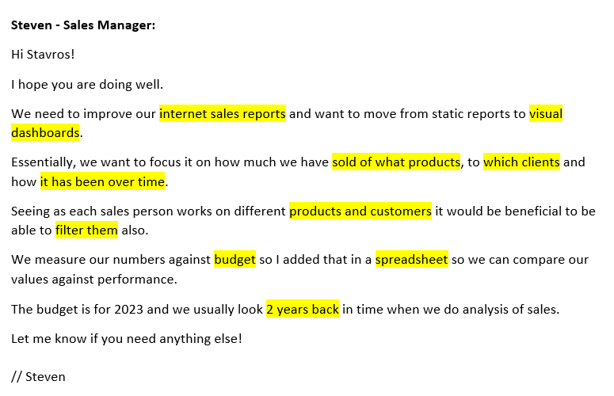
Business Request:

Slide 5
Business Demand Overview:
Reporter: Steven – Sales Manager
Value of Change: Visual dashboards and improved Sales reporting or follow up or sales force
Necessary Systems: Power BI, CRM System
Other Relevant Info: Budgets have been delivered in Excel for 2023
User Stories:
No # | As a (role) | I want (request / demand) | So that I (user value) | Acceptance Criteria
1 | Sales Manager | To get a dashboard overview of internet sales | Can follow better which customers and products sells the best | A Power BI dashboard which updates data once a day
2 | Sales Representative | A detailed overview of Internet Sales per Customers | Can follow up my customers that buys the most | A Power BI dashboard which allows me to filter data for each customer
3 | Sales Representative | A detailed overview of Internet Sales per Products | Can follow up my Products that sells the most | A Power BI dashboard which allows me to filter data for each Product
4 | Sales Manager | A dashboard overview of internet sales | Follow sales over time against budget | A Power Bi dashboard with graphs and KPIs comparing against budget.

Slide 6
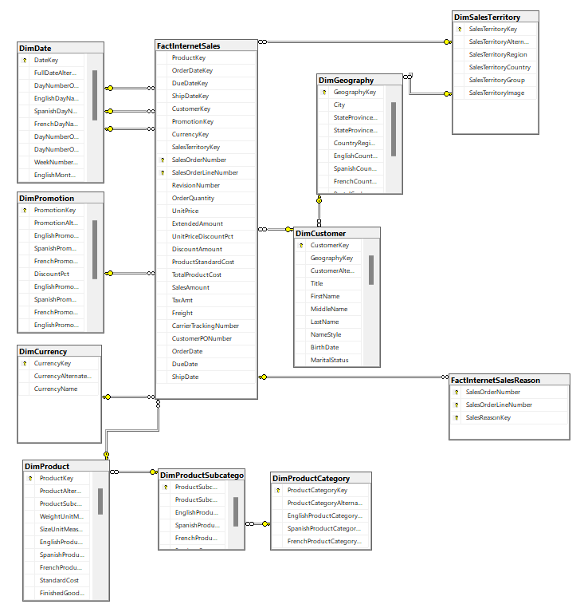
Internet Sales Area
The Internet Sales area in the Adventure Works DW 2022 database follows a star schema design.
Components of Internet Sales:
FactInternetSales: This is the central table that contains the measurable business data related to internet sales transactions.
Dimension Tables
DimCustomer
DimProduct
DimDate
DimSalesTerritory
DimCurrency
DimPromotion

Slide 7
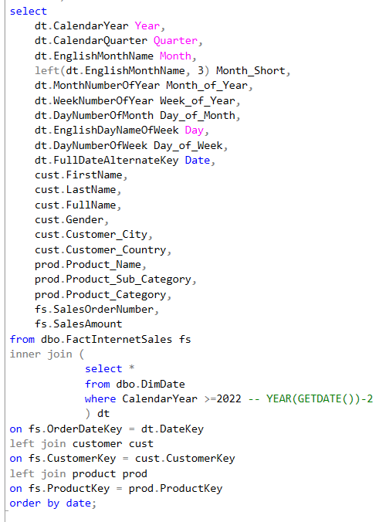
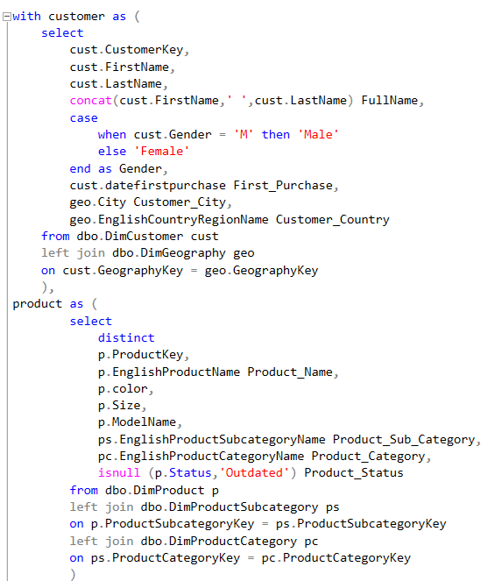
Creating a compact report gathering the needed fields based on stakeholders’ requirements:

Slide 8
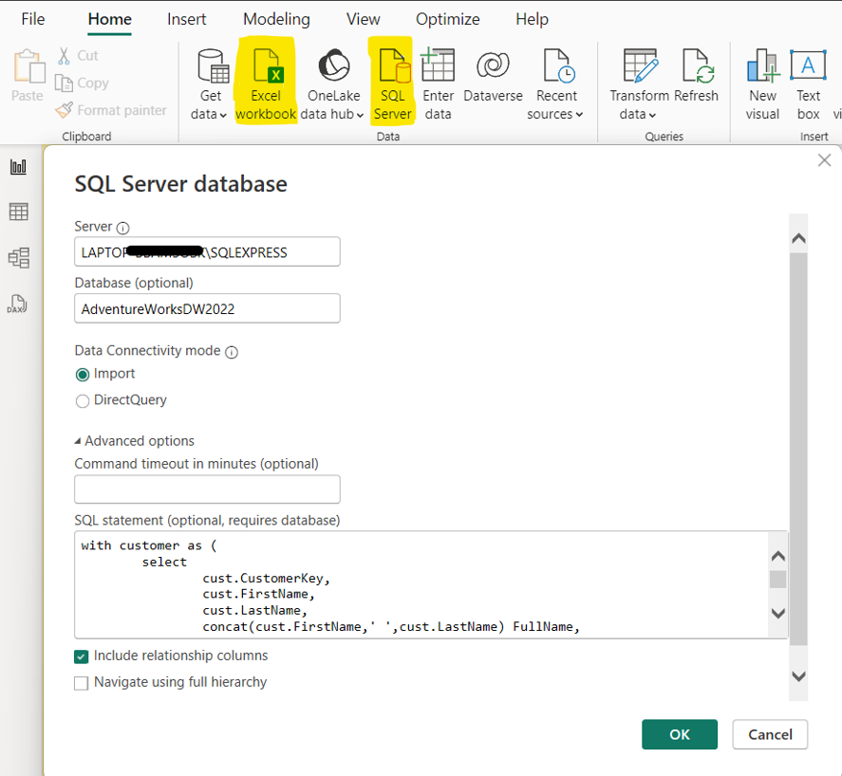
Importing Data to Power BI
Utilizing the “SQL Server” data import option, we connect to our database through Power BI, gaining access to all available tables.
Additionally, since we have already created a compact report with an SQL query, we use the "SQL Statement" window to retrieve the custom table upon which we will create our visualizations.
Finally, having received data through an Excel spreadsheet from the stakeholders, we use the “Excel workbook” data import option to upload the Excel data to Power BI.

Slide 9
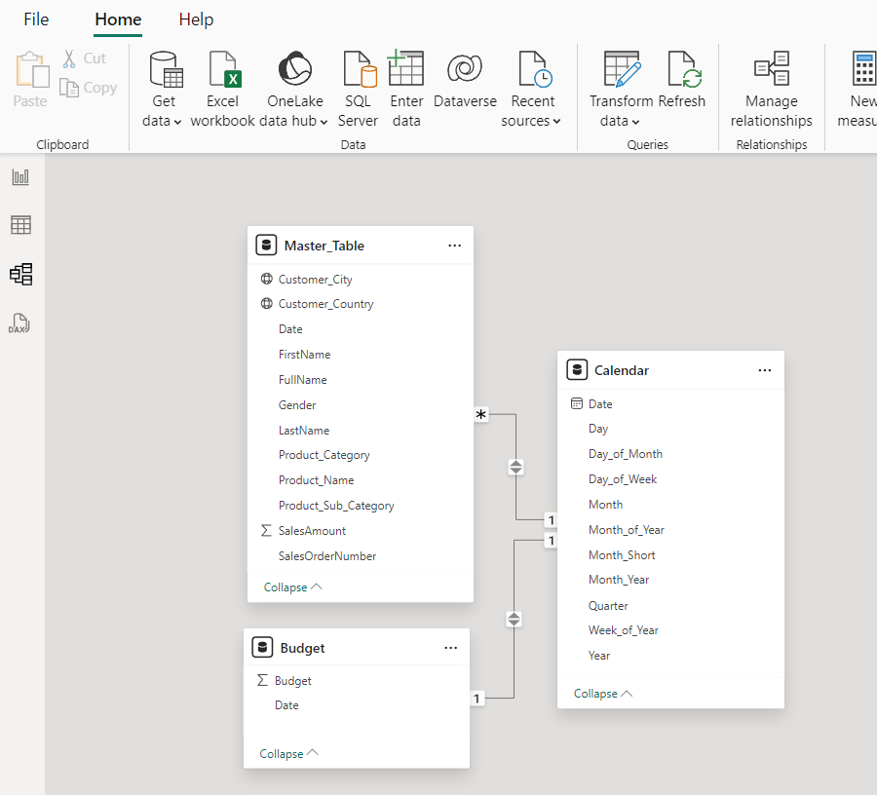
Data Model
Having already joined all the required tables with my SQL query, I end up with a relatively simple data model consist of 3 tables:
Master_Table: Contains all the relevant fields based on the business request after joining the required dimension tables with the fact table.
Budget: This table is sourced from the Excel Spreadsheet provided from stakeholders containing the budget sales amounts per year and month.
Calendar: To enhance data organization and facilitate filtering by time period, I created the Calendar table. This table is used to filter data according to the desired time periods.

Slide 10
Dashboards and Features
Sales Overview Dashboard
The "Sales Overview" dashboard provides a comprehensive analysis of sales performance by comparing actual sales against budgeted targets. It includes key metrics such as total sales amounts, variance in absolute and percentage terms, and displays the top 10 customers and products. The dashboard also features a geographical map showing customer locations and allows for detailed filtering by time period (year, month), product category, and customer country. This enables stakeholders to gain a clear understanding of sales trends and regional performance.
Customer Details Dashboard
The "Customer Details" dashboard offers an in-depth view of sales data by customer. It highlights total actual and budgeted sales amounts, showcases the top 10 customers, and provides a geographical representation of customer locations. The dashboard allows users to filter by product sub-category, product category, city, and country, making it easy to analyze sales performance across different customer segments and regions. This tool helps identify key customers and understand their purchasing behavior over time.
Product Details Dashboard
The "Product Details" dashboard delivers a detailed analysis of sales by product. It displays total actual and budgeted sales amounts, lists the top 10 products by sales, and includes a world map to show where products are sold. Users can filter the data by product sub-category, product category, city, and country to focus on specific products and regions. This dashboard is essential for understanding product performance, identifying best-sellers, and analyzing sales distribution across different markets.

Slide 11
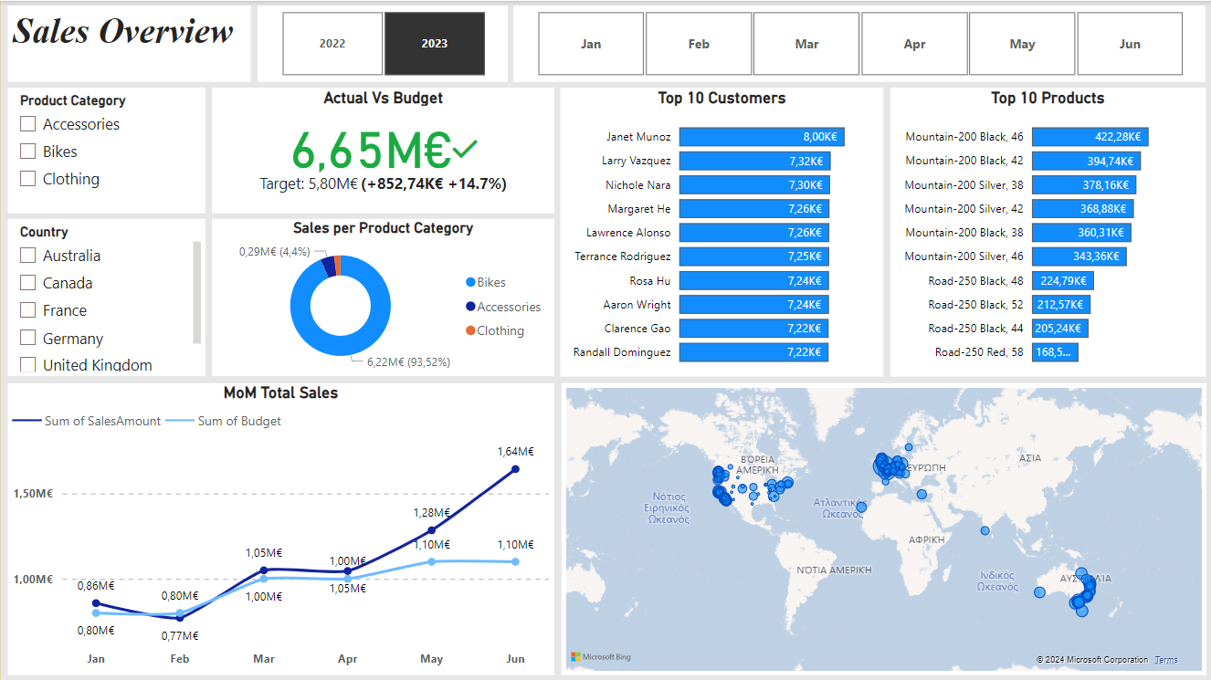

Slide 12
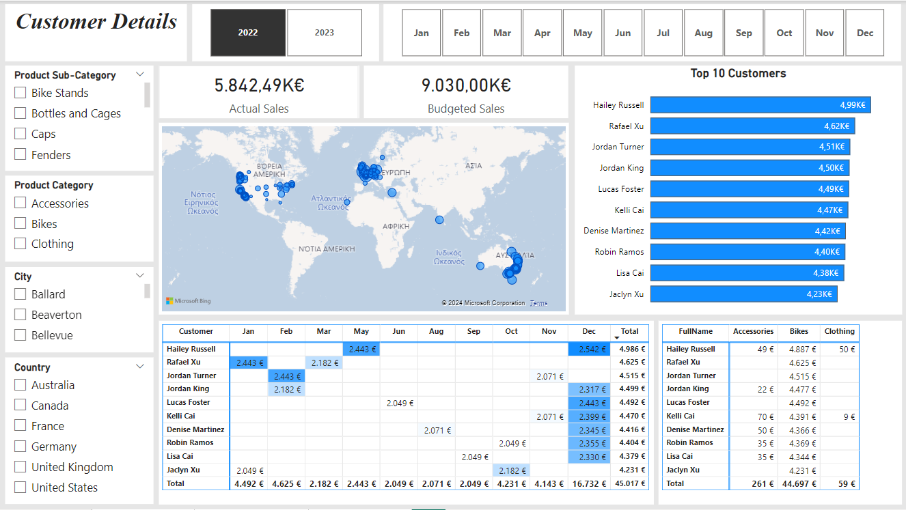

Slide 13
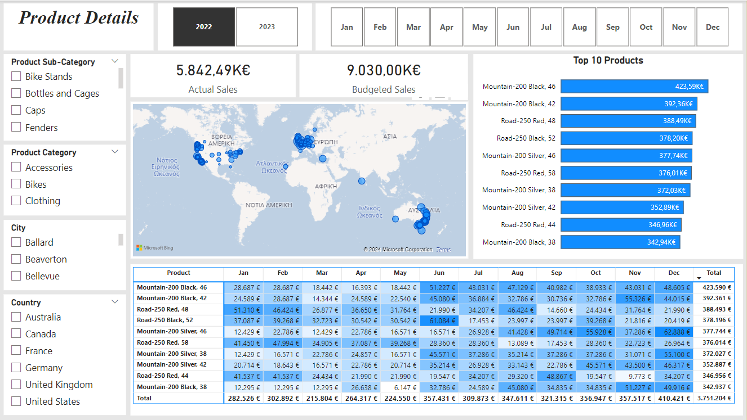

Slide 14
Thank You
Stavros Xakis

